Slide 1
Discrimination in ITE
Rachel Koh - 1733871 [DMAT] Farhan - 1702486 [DGDD]

Slide 2
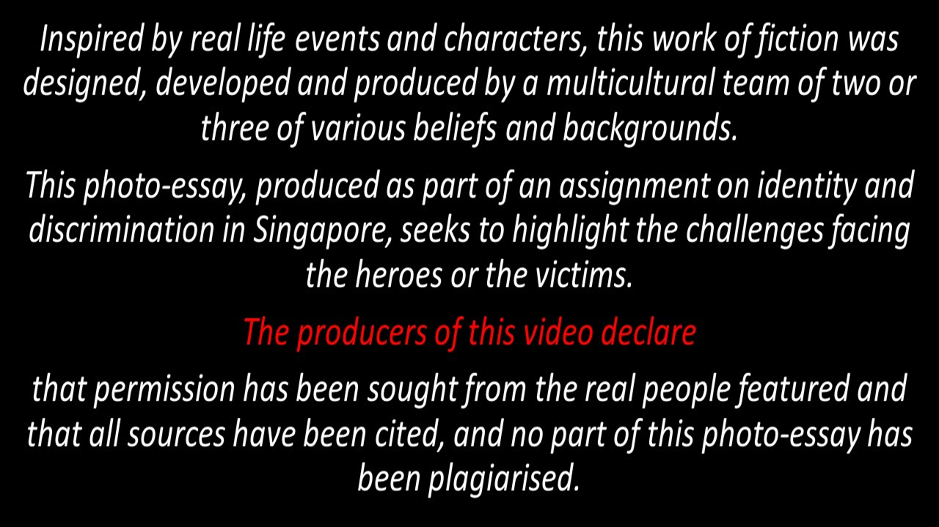

Slide 3
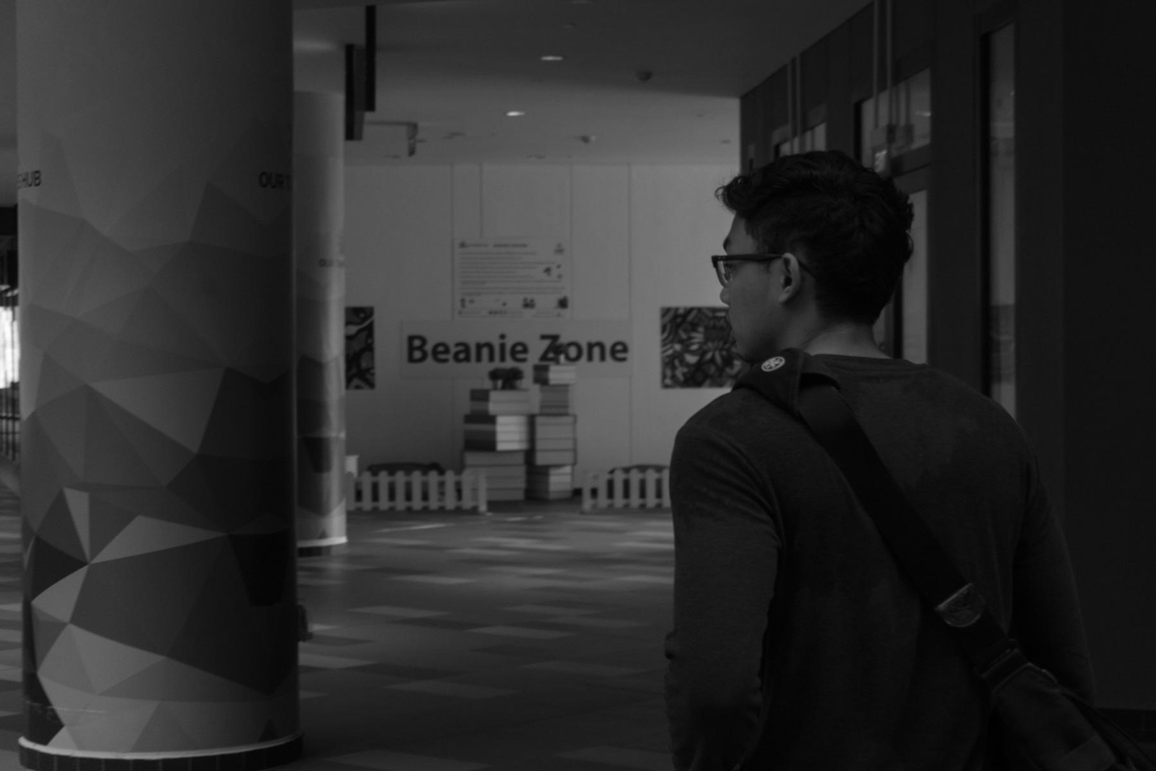
Meet our protagonist!
This is Nizam!

Slide 4
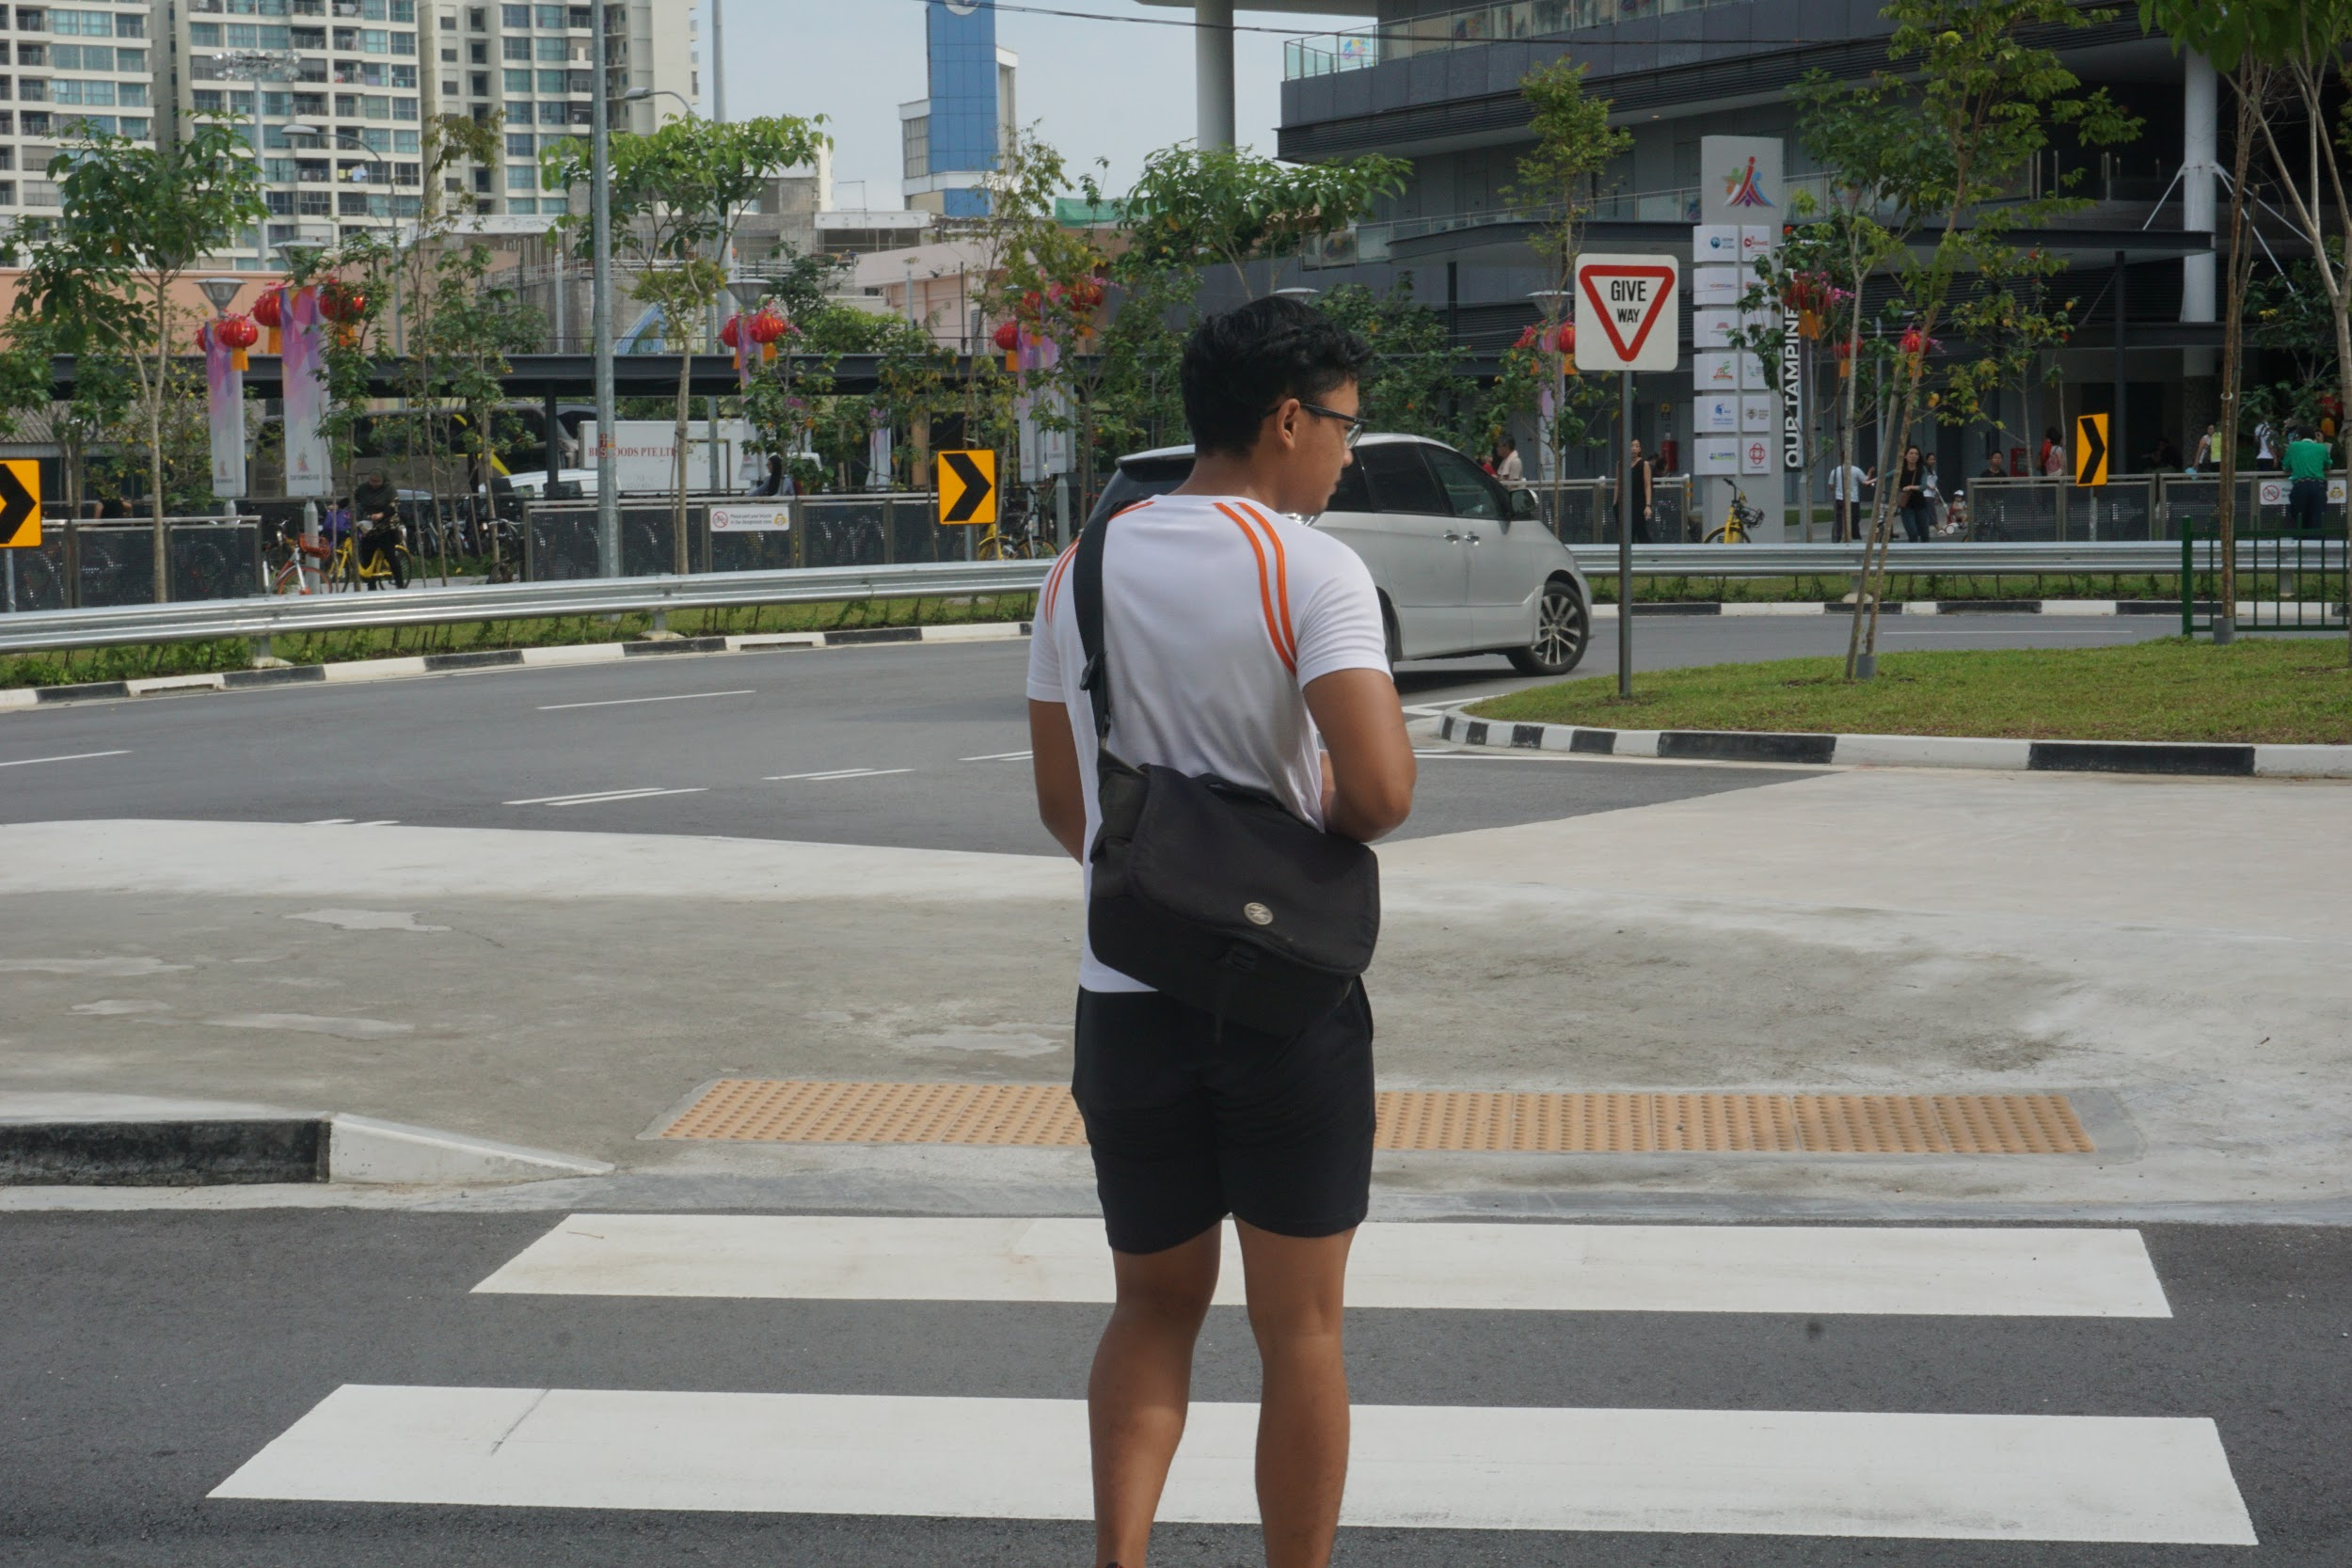
Who is Nizam?
He’s from ITE College East and studying Mechanical Engineering. This is his story of how he overcame discrimination.

Slide 5
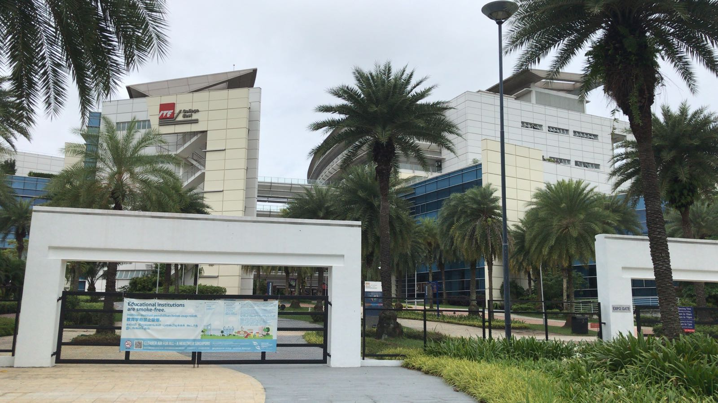
What is ITE?
ITE refers to “Institute of Technical Education” and imparts employment skills as an academic institute based in Singapore to provide occupational expertise to secondary school graduates who wish to continue studying, preparing them for the working world, and serves as a tertiary education for such students.

Slide 6
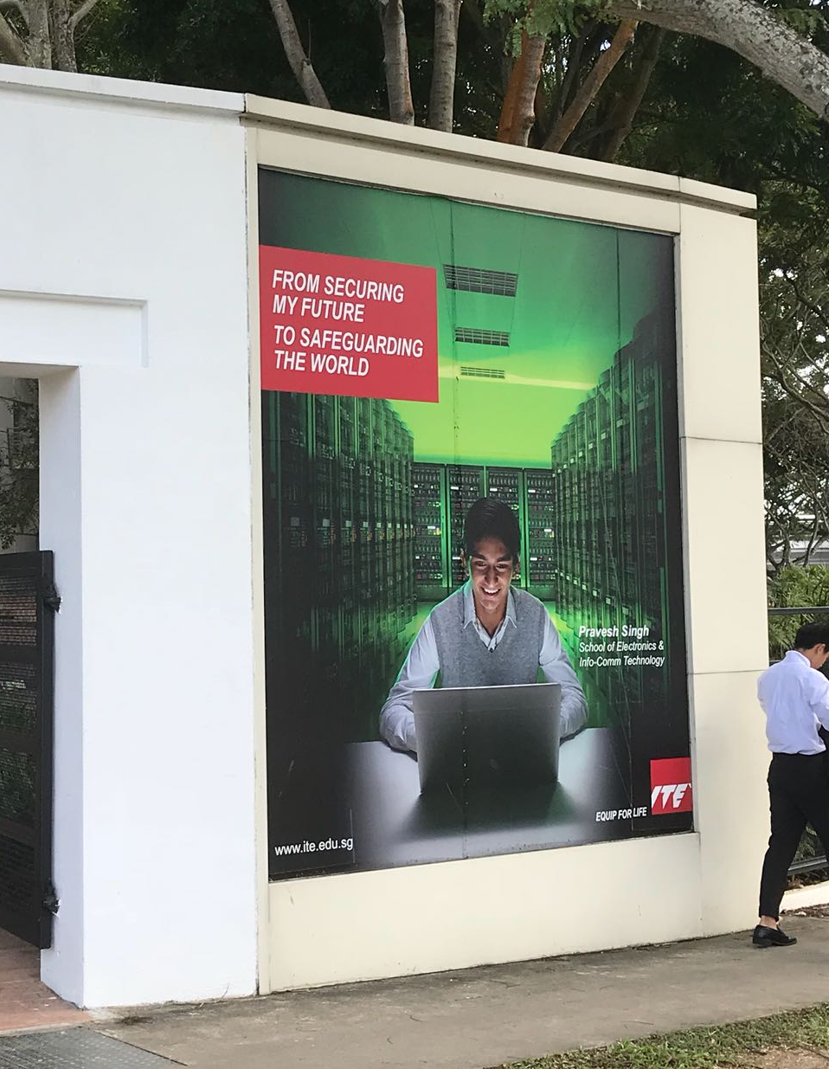
Some statistic on ITE

Slide 7
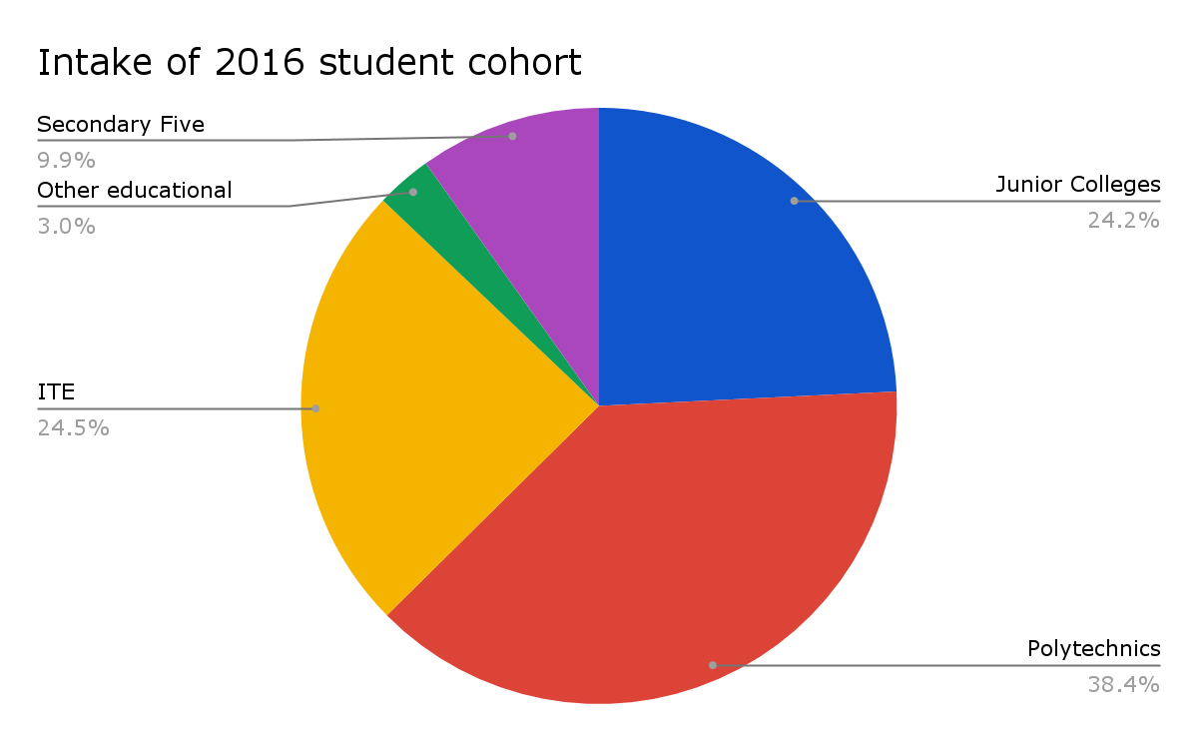
That’s 14,763 intakes into ITE out of 60,260 students in 2016.

Slide 8
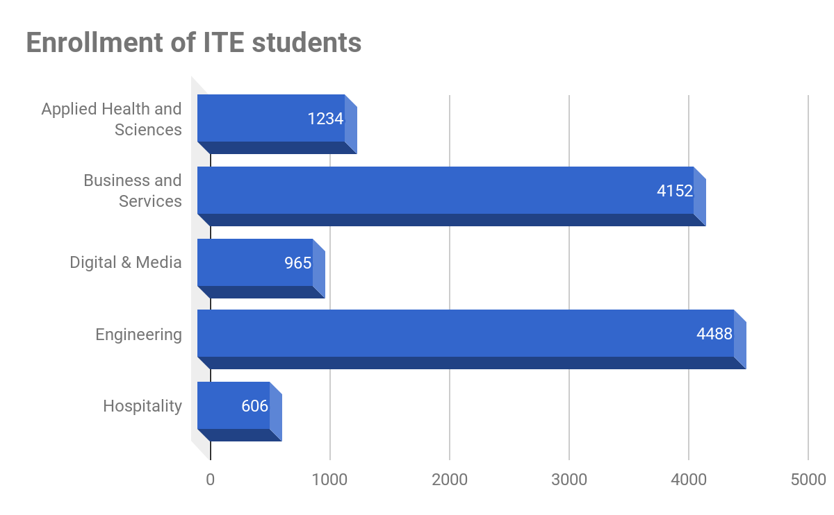
The highest number of students enter engineering & next being business and services

Slide 9
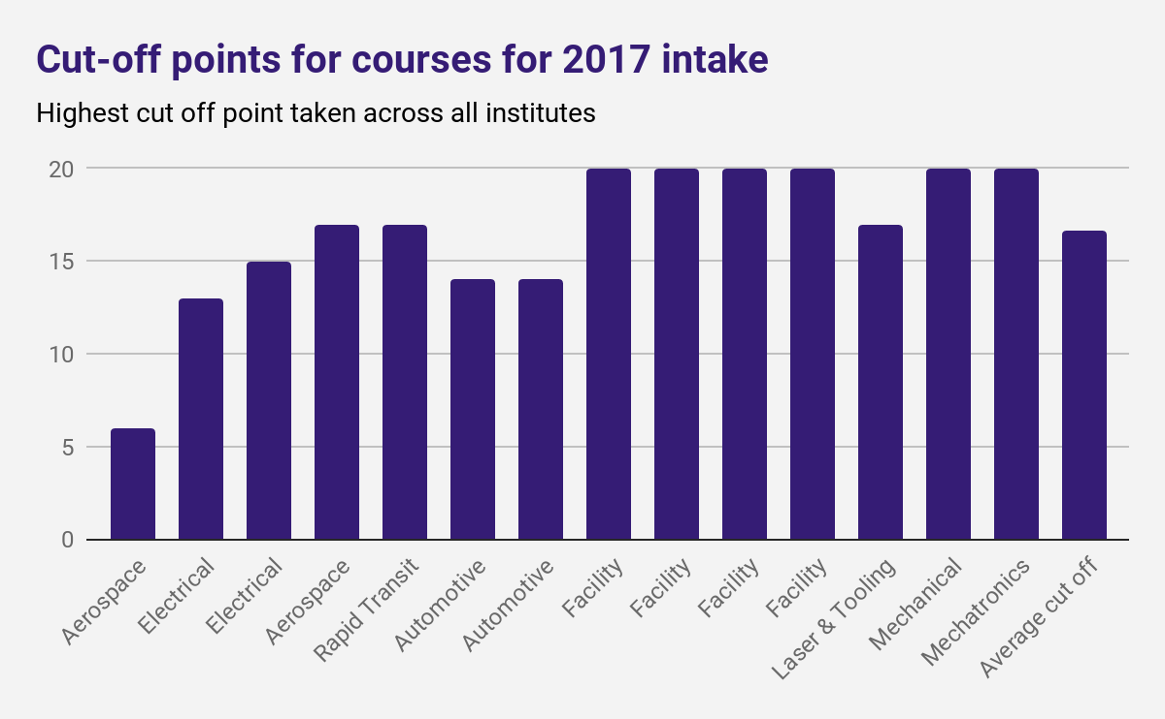
Cut off points are generally around 20 points, the average being 16.

Slide 10
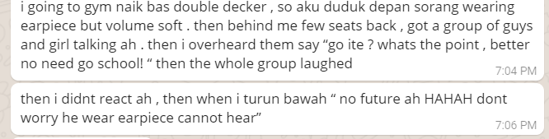
So what’s Nizam’s story?
Translation: “I was going to the gym via a double decker bus, so I sat alone in front, listening to music, but softly. A few seats back was a group of guys and girls having a conversation. I overheard them saying “Go ITE? What’s the point? Better no need go school!”, and the whole group found it hilarious. When I got off at my stop, they said “no future lah, but don’t worry, he wearing earpiece, cannot hear us.”
A message from Nizam telling us an event when he was mock by a group of students whom he wish not to tell which school they were from

Slide 11
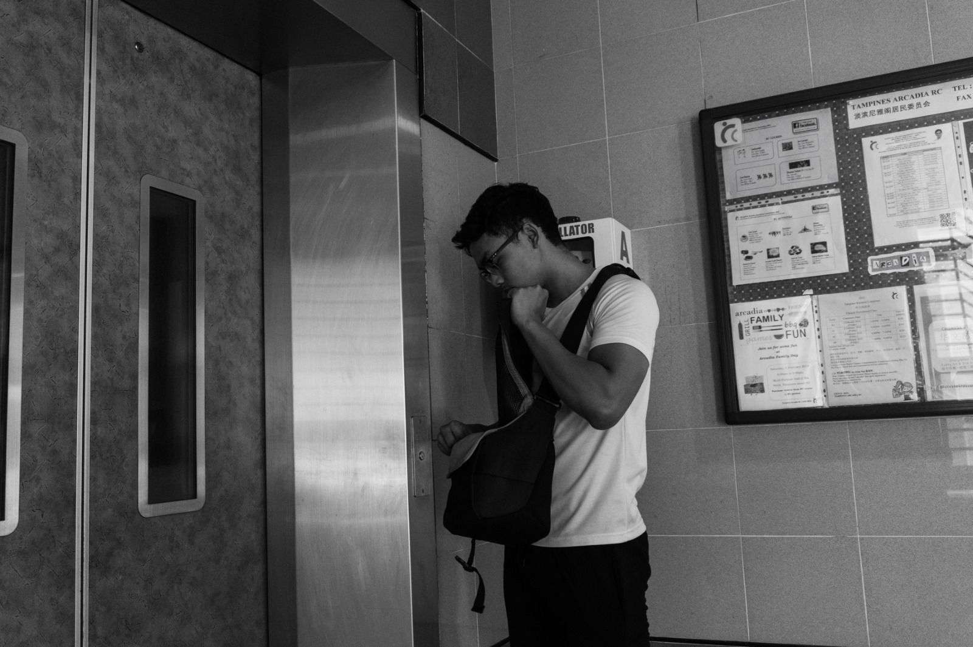
So what’s Nizam’s story?
Although it is very common in Singapore to joke about our norms, some jokingly use ITE as a means of teasing and may unintentionally hurt people, like Nizam. This shows that society may contextualise stereotypes, which may lead to discrimination and in worse case, make some ITE student really believe that they really are hopeless.

Slide 12
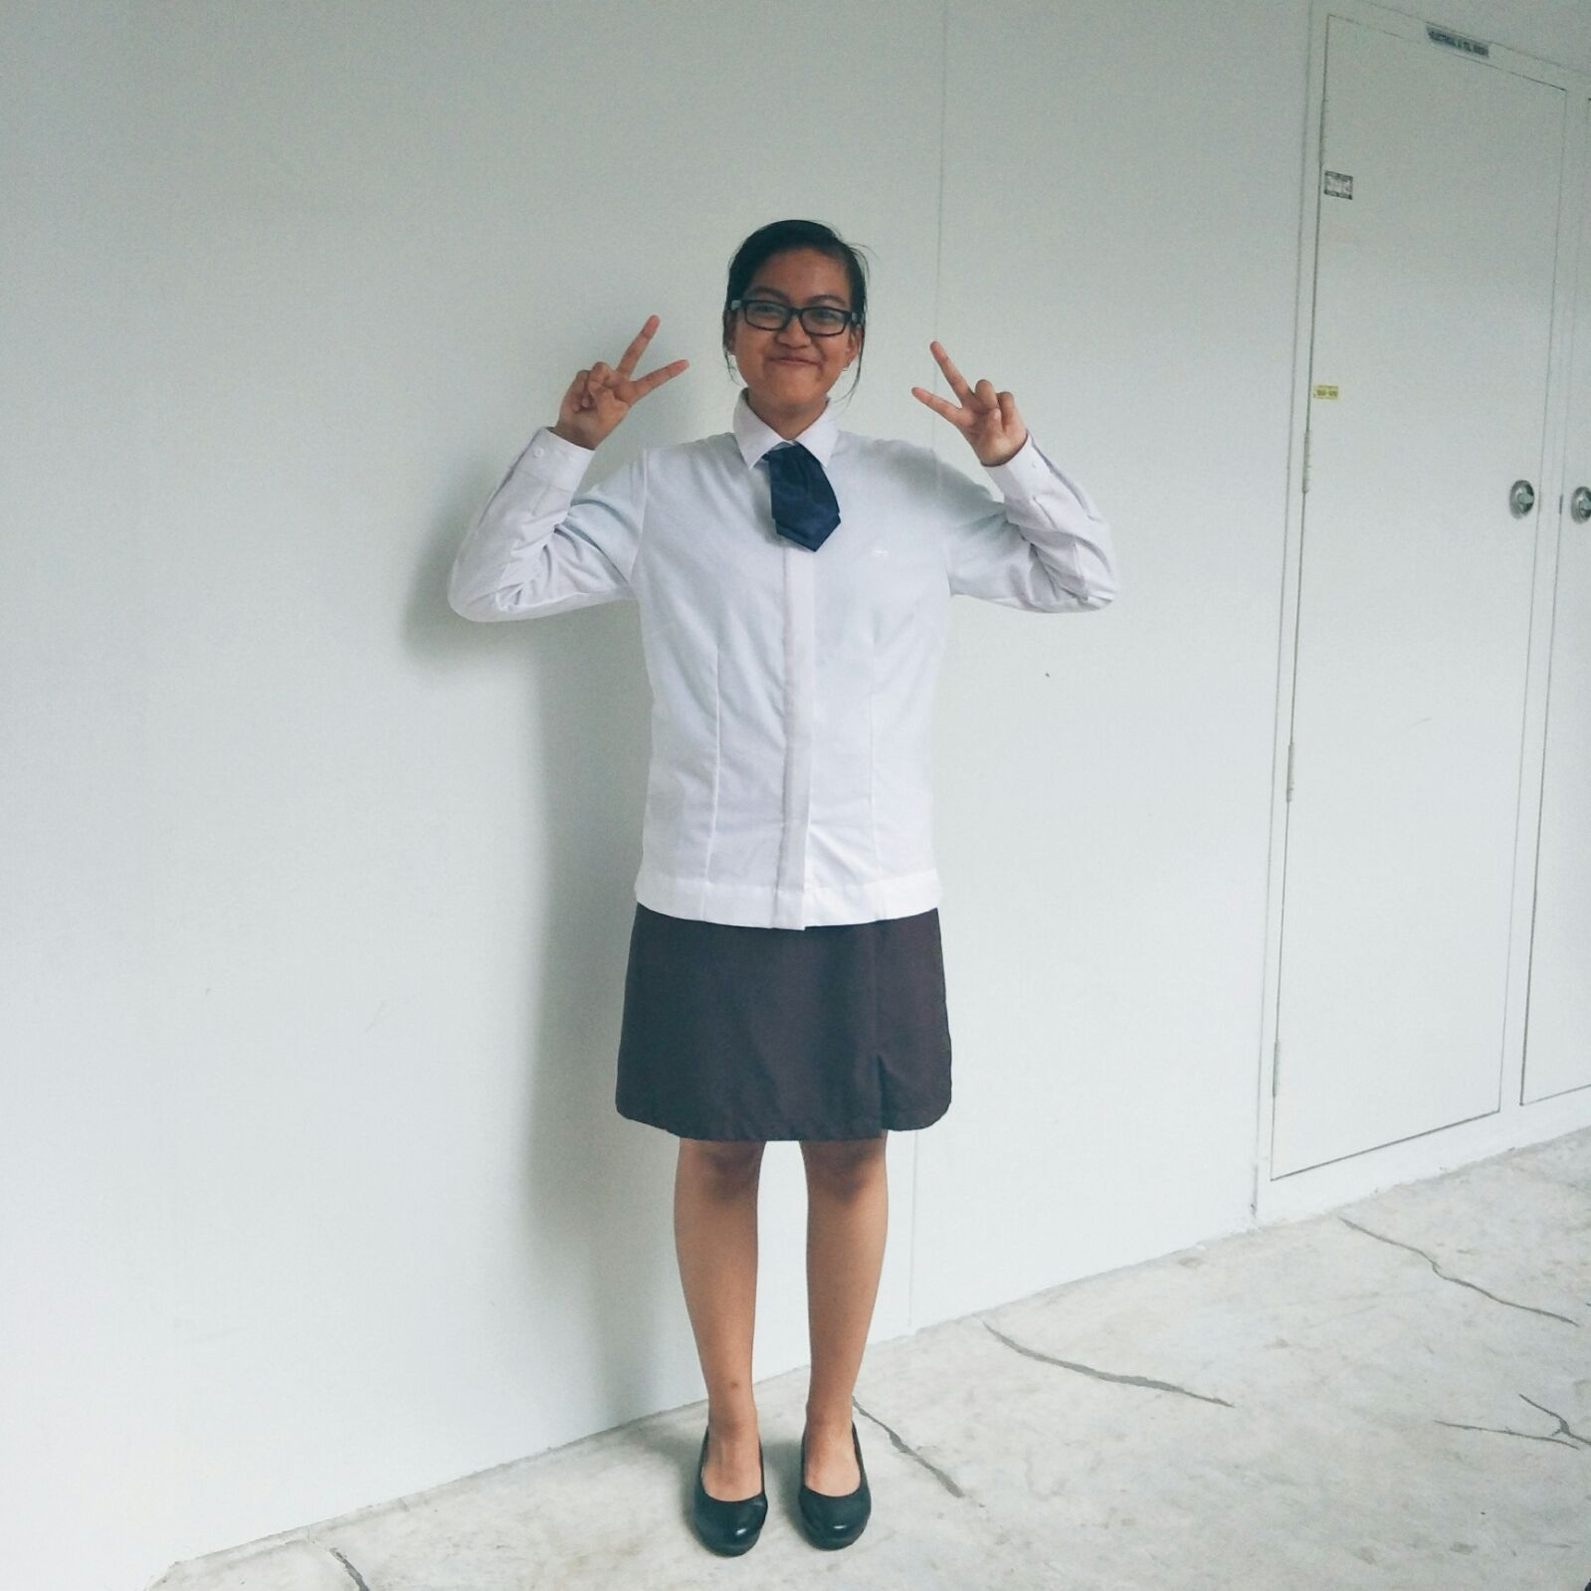
This is Nizam’s secondary school classmate, Haziqah
She was studying in ITE College West

Slide 13
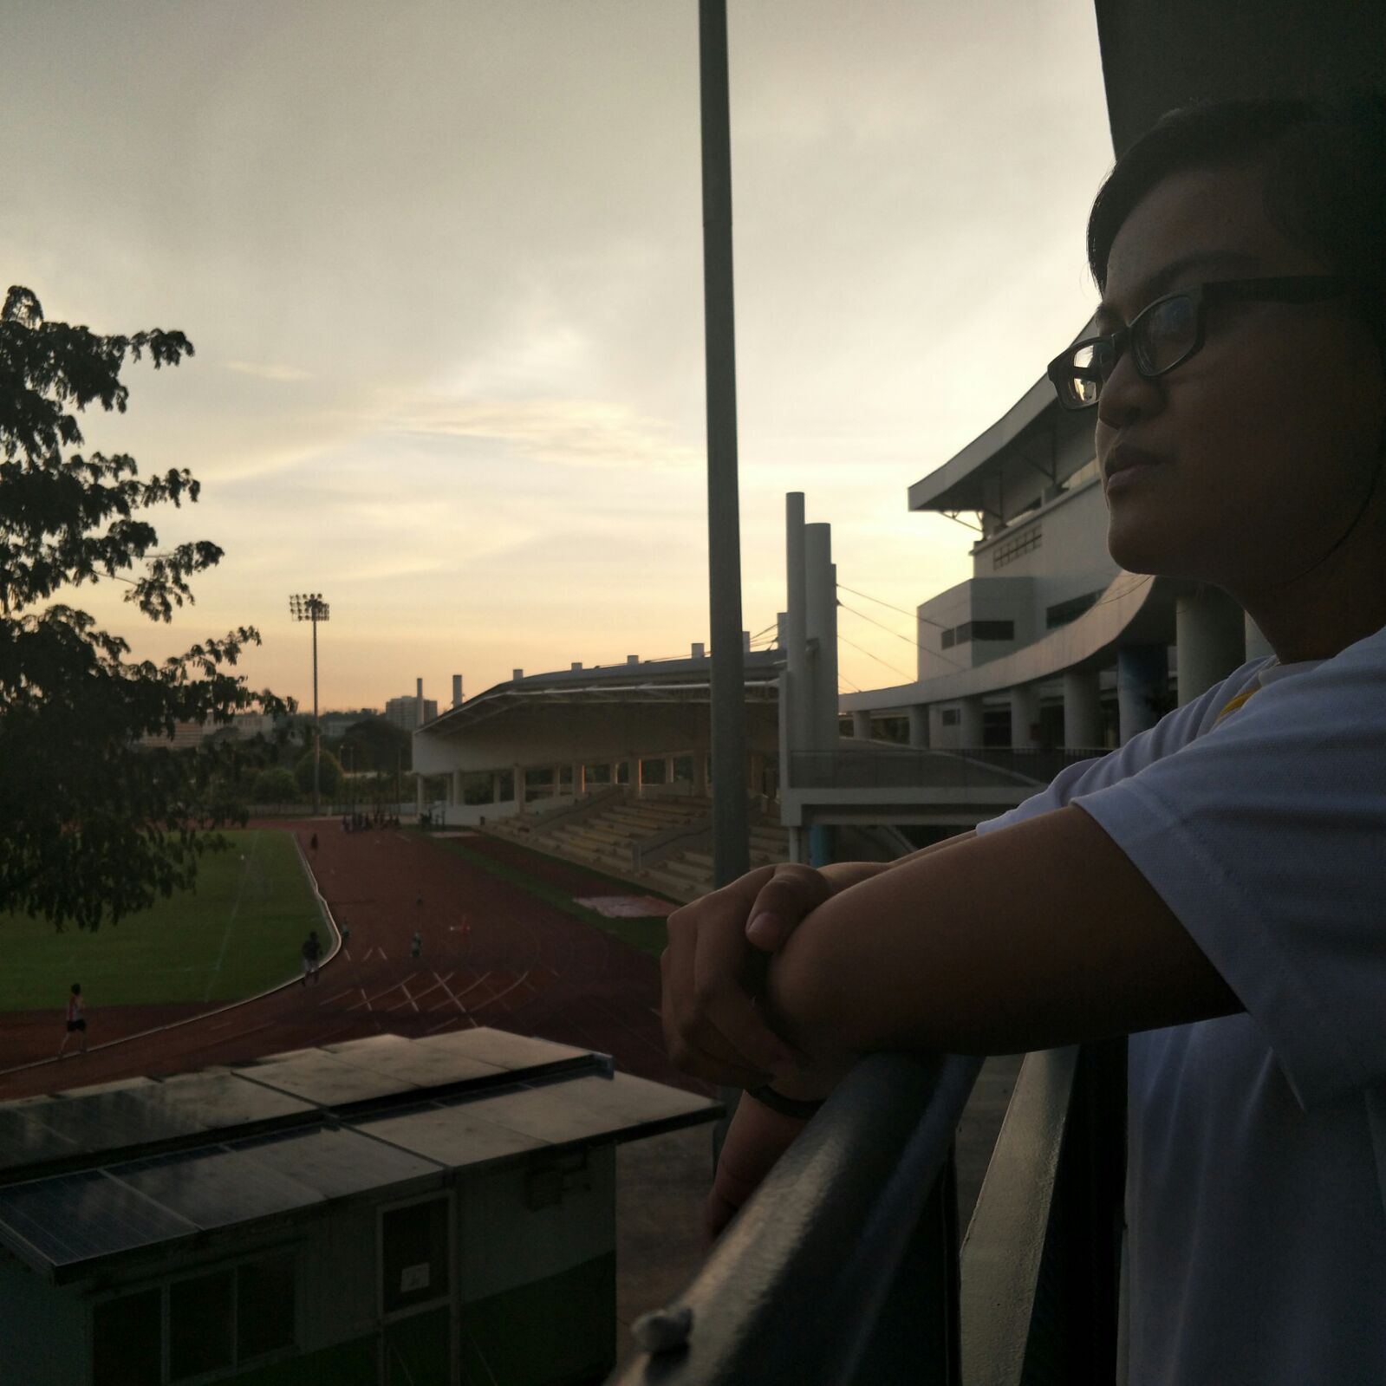
Although Haziqah hasn’t been the brunt of the discrimination...
“My parents always had bigger dreams for me to continue on to Secondary 5 but they expected that I would end up in ITE. Even if they didn't look at me differently, they still supported me for my decision to join ITE. They feared that ITE would influence me to join gangs, and pick up bad habits like smoking or loitering around in public.”

Slide 14
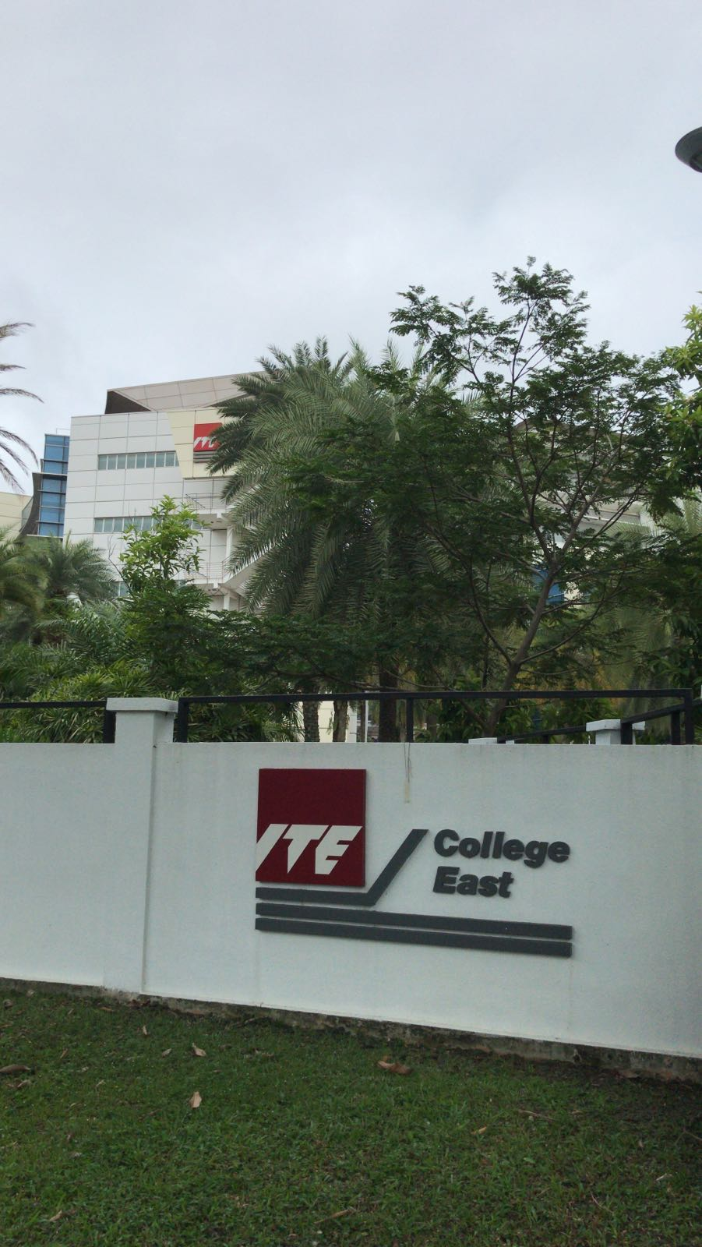
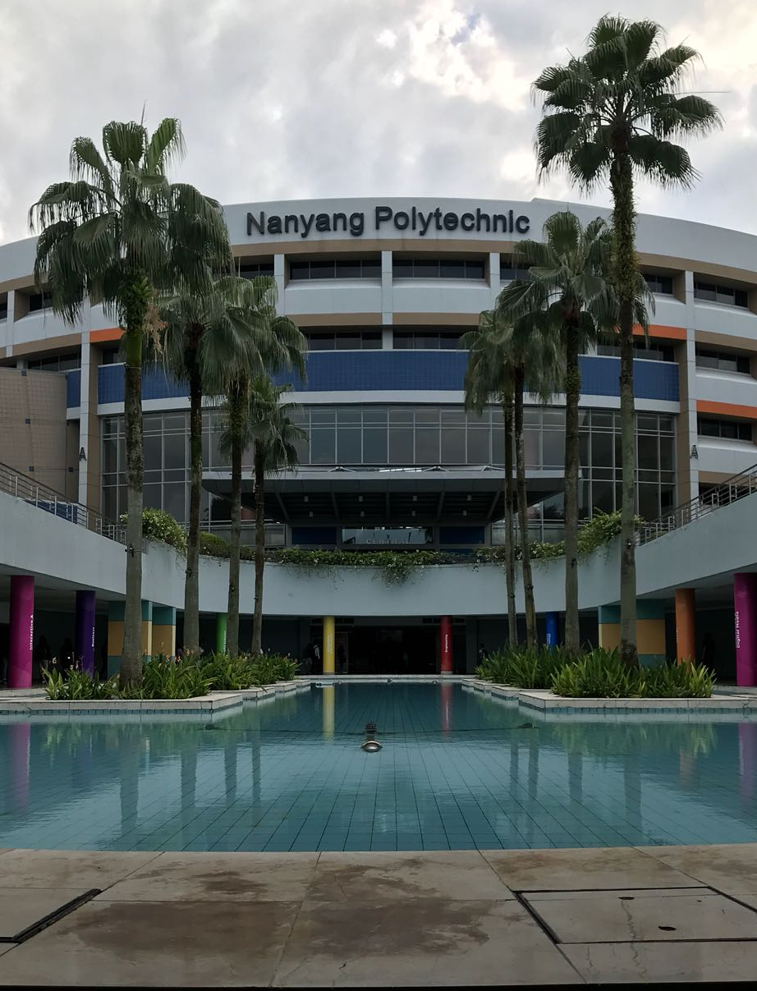
Many Singaporeans have the impression that ITEs are for failures.
Even though ITEs, polytechnics and junior colleges all serve a similar purpose, ITEs are not seen as on par to the other tertiary educational institutes, and are considered the black sheep of the lot. Why is that so?

Slide 15
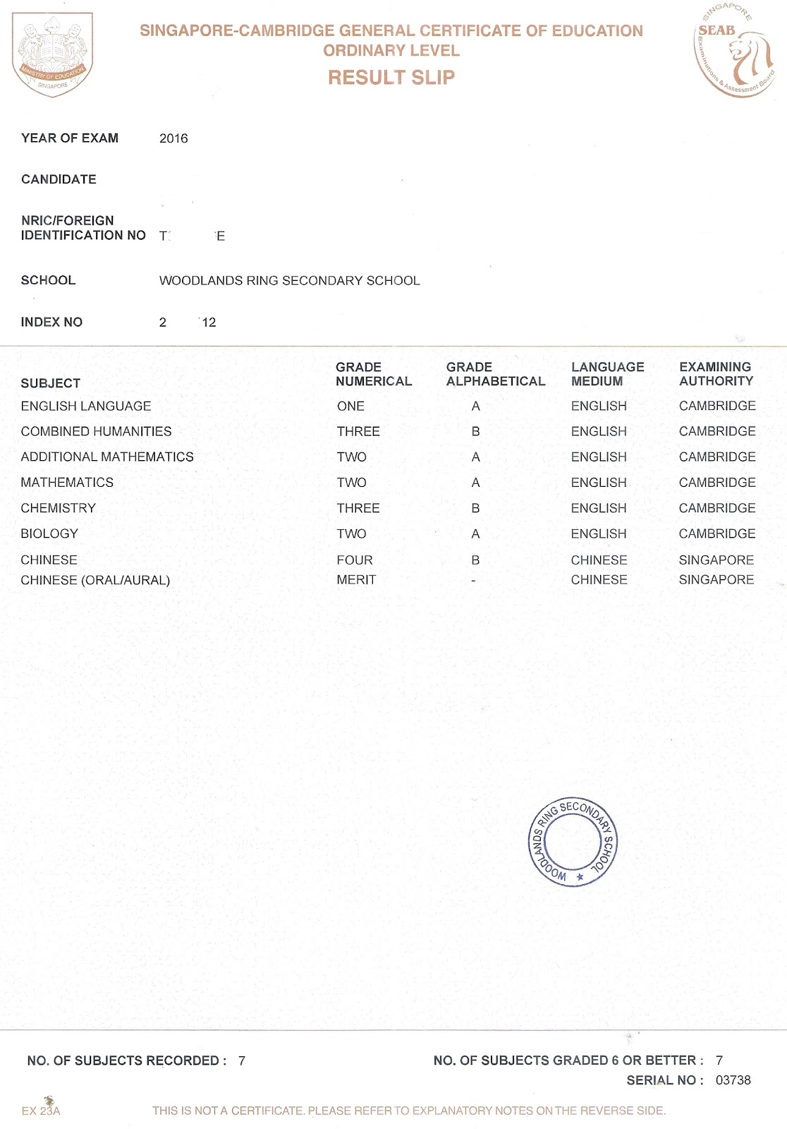
Good grades = good days ahead
Grades are everything
Singaporeans are typically more “selfish” and want the best for themselves. This mindset causes them to press their children for achieve good grades as they believe it is best for them. This however may lead students may feel disappointed because they are unable to live up to the expectations of their parents.

Slide 16
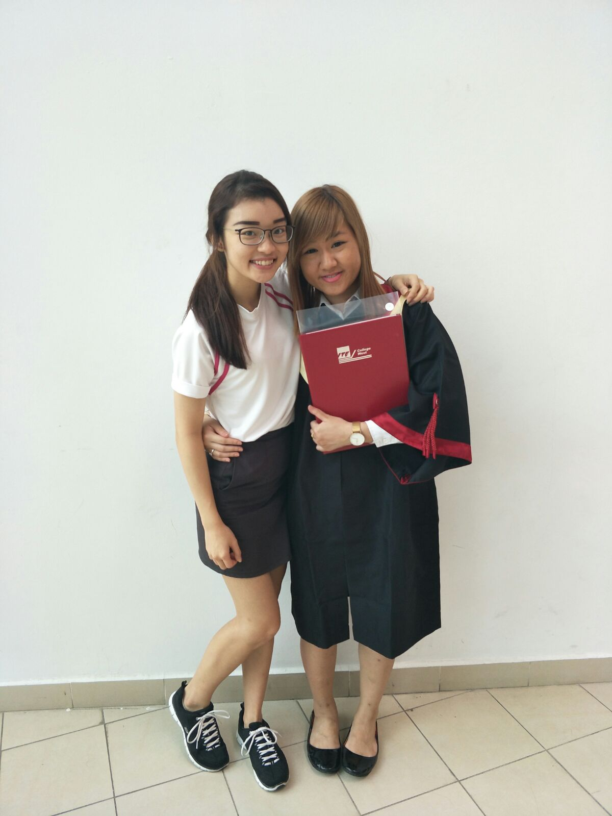
Singaporeans have been brought up with the mentality “the degree brings the money”
People usually view a degree holder as someone successful or financially secured. This mentality has influenced many to have a bad impression on ITE students, and assume that these students will not earn much money in the future. However, this is not true.

Slide 17
This in turn causes...

Slide 18
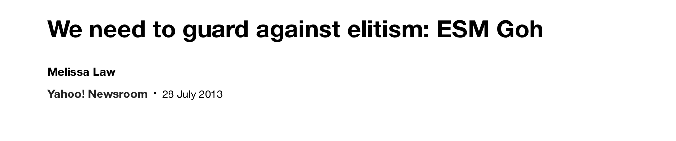
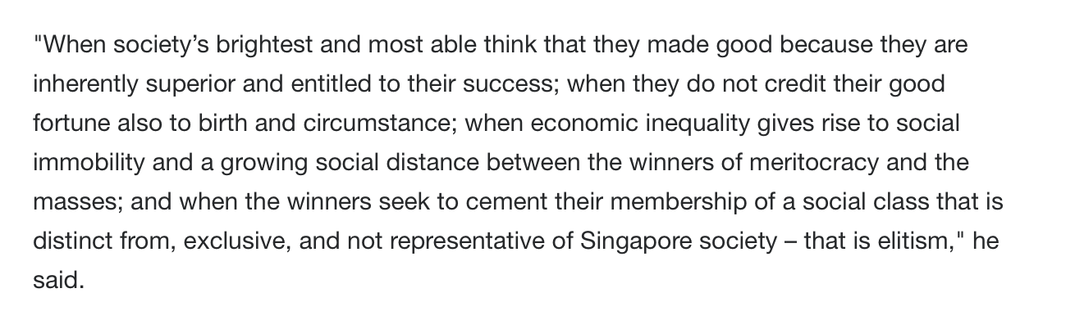
Better schools = better life ahead
People think being in an elite school opens reservoirs of larger government funds for activities such as overseas enrichment programmes have even more budget to get better educators in the institution, or better connections for promising jobs or universities.
Article about elitism in singapore

Slide 19
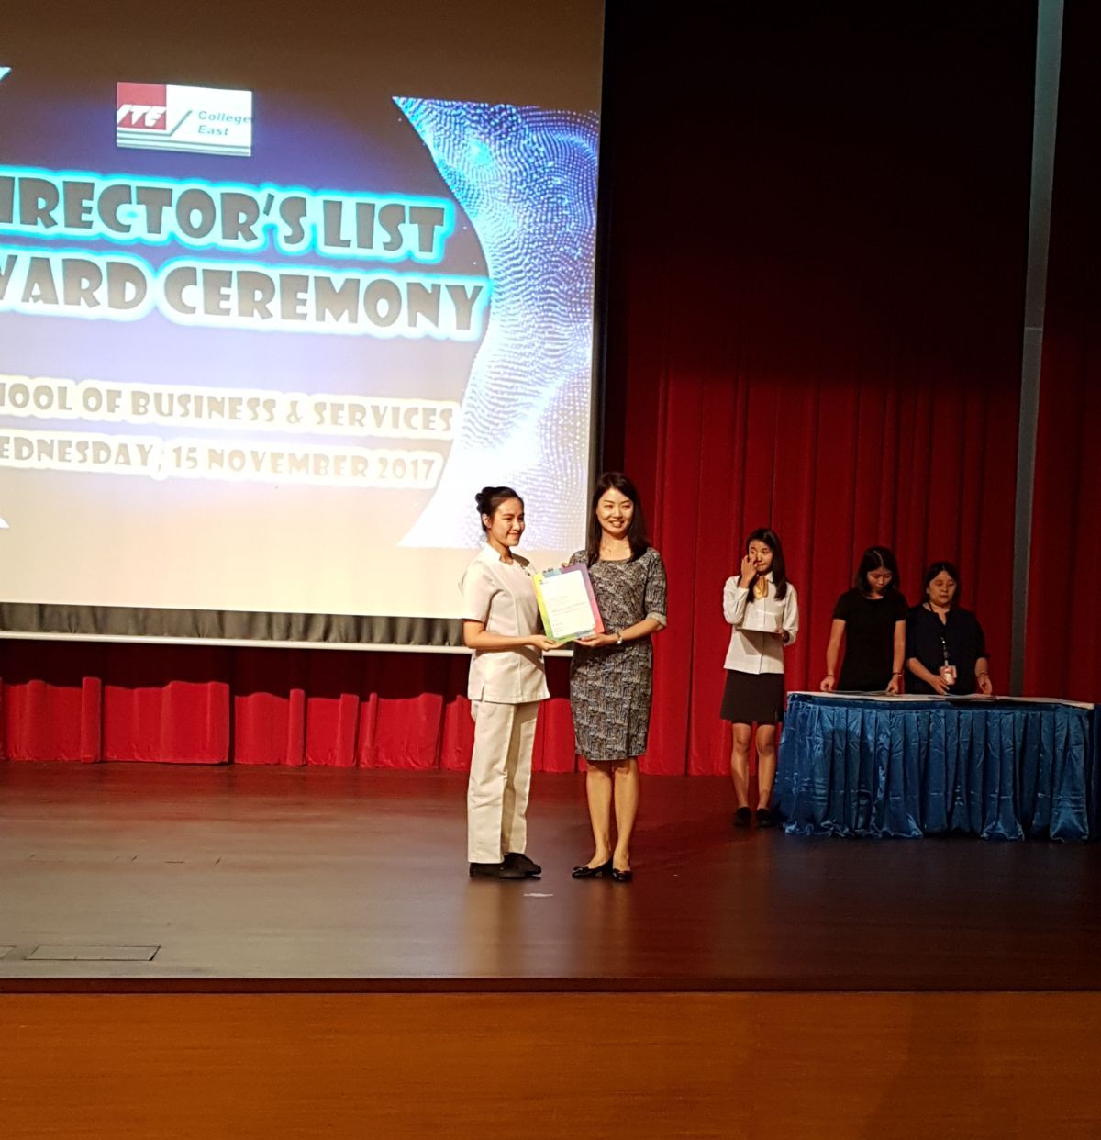
Meritocracy in Singapore
“Today, the Singaporean idea of meritocracy is criticized for entrenching structural limits on mobility; for its overly narrow idea of merit and success; and for an increasingly self-regarding elite that seems too interested in staying in power and that citizens perceive as arrogant and unresponsive to their needs.”
A passage from an article talking about meritocracy in Singapore
Meritocracy is a political philosophy which rewards people by their talent and skill.
Singapore uses this system for the benefit of financially weaker students who are potentially academically stronger. However, this causes some to become complacent. The obvious one being elitism

Slide 20
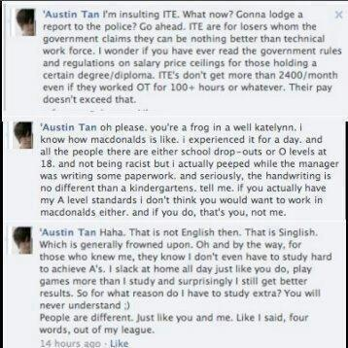
Elitism and discrimination
Some Singaporeans view ITE students as inferior, and self proclaim the right to mock them, with the impression that ITE students and intellectually weak and tend to fail their exams. This toxic elitist attitude causes them to target ITE students.
A post made by a student from a “higher” tertiary school

Slide 21
Putting on an identity
“Every year, four in ten students fail to make it to the polytechnics after the O levels. Of this number, half will end up entering the Institute of Technical Education (ITE) to gain vocational skills in preparation for skilled work. Although it is still possible for ITE students to earn a place in the polytechnics after two years of vocational education, students must be within the top two per cent of their 32,000-strong cohort.”
In an interview with Channel News Asia, Associate Professor Irene Ng, from the Social Work Department at the National University of Singapore, said: “Whenever you have a category, people will assign prestige or stigma to it. And so people will all go for that prestigious group, for example the Integrated Programme. Or, people will assign a stigma to a programme that’s not so popular.“There’s also research that shows that when you assign a label to somebody, the person will behave according to that way, it’s a self-fulfilling prophecy. So for example if we teach students in the Normal (Technical/Academic) stream to a low level because we think that is the level, then students could react to it, and give you back what you think you want.”
With the aid of society, Singapore have made this sort of education hierarchy.
They will set up an idea on what and how a certain education position a person who is in should be seen and viewed
People will tend to see himself as smarter and better than other when place in a “prestiges” place or a position when people praising you just for being there is common. They will build this pedestal for this position and unsurprisingly, everyone wants to go there, or that's what everyone thinks that is
This however causes people to think ill of those bottom of the hierarchy and will place stigma on this position. This will likely cause people to just see this stigma as fact and ended up not seeing people of lower education position as person of different taste and passion but rather a person who fail to get a spot at the “good” spot and that they are not “good” enough due to them being lazy or being a delinquent.
A passage from an article talking about stigma and social hierarchy in Singapore’s education system

Slide 22
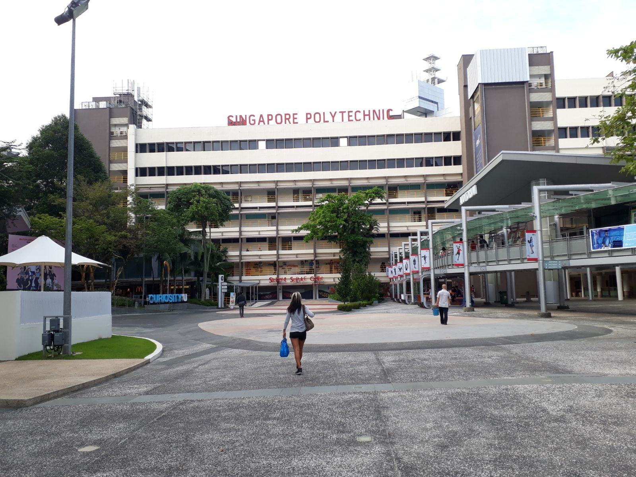
Fear of entering polytechnics
I definitely fear rejection. I feel like giving up because I felt like I didn't give it my best when I know I already did. At the same time, I have faith that I can survive. I know that I have at least my strengths and new-found skills that I can use when I enter Polytechnic and the working world.
-Haziqah

Slide 23
Fear of entering polytechnics
I’m afraid of being outcasted as “that guy” just because of being in ITE. I’m afraid of not being accepted by my peers and ended up being alone for my entire Poly life. I want to show them that although i came from ITE, i can still succeed in my studies and prove to all that ITE does not equal to the end. You’re just taking a longer path that's all
-Nizam

Slide 24
Politics

Slide 25
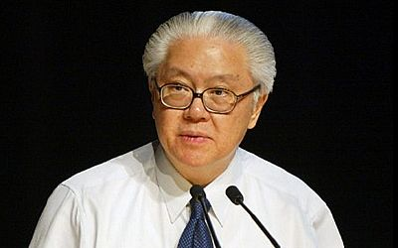
'ITE and Poly education is "bad rubbish"' – Did Tony Tan say that?
Although this claim is still up to debate, it does show that politics and education are both connected.
It also show how a politician(or person of power/importance) can affect how we feel about certain things. Some people will be influence by powerful people and will agree and some cases preach the views said by the people they support. In another case, people can use this excuse to justify their claim in how ITE(and poly) are rubbish and we should not support people who want to go to this institution and view them as failures.
Although it's still up to debate whether or not what say was true or not, this does show that the politician view on education can impact how people feel about it as well as people will quickly use this claim to either justify or attack other people’s views and opinion and also,depend on who is saying it, can change our viewpoint on this type of issues.
Tony tan here please*

Slide 26
Solution

Slide 27

More funding's for students who generally perform above average
Haziqah receiving her award

Slide 28

ITE = FAILURE
We as a society must break this stigma of seeing ITE students as failure.
Studying in ITE does not equal failure. Same goes with how being in JC or Polytechnic does not equal to success. Success can only be achieve by how that person do with the opportunity given to him and the attitude that person has.

Slide 29
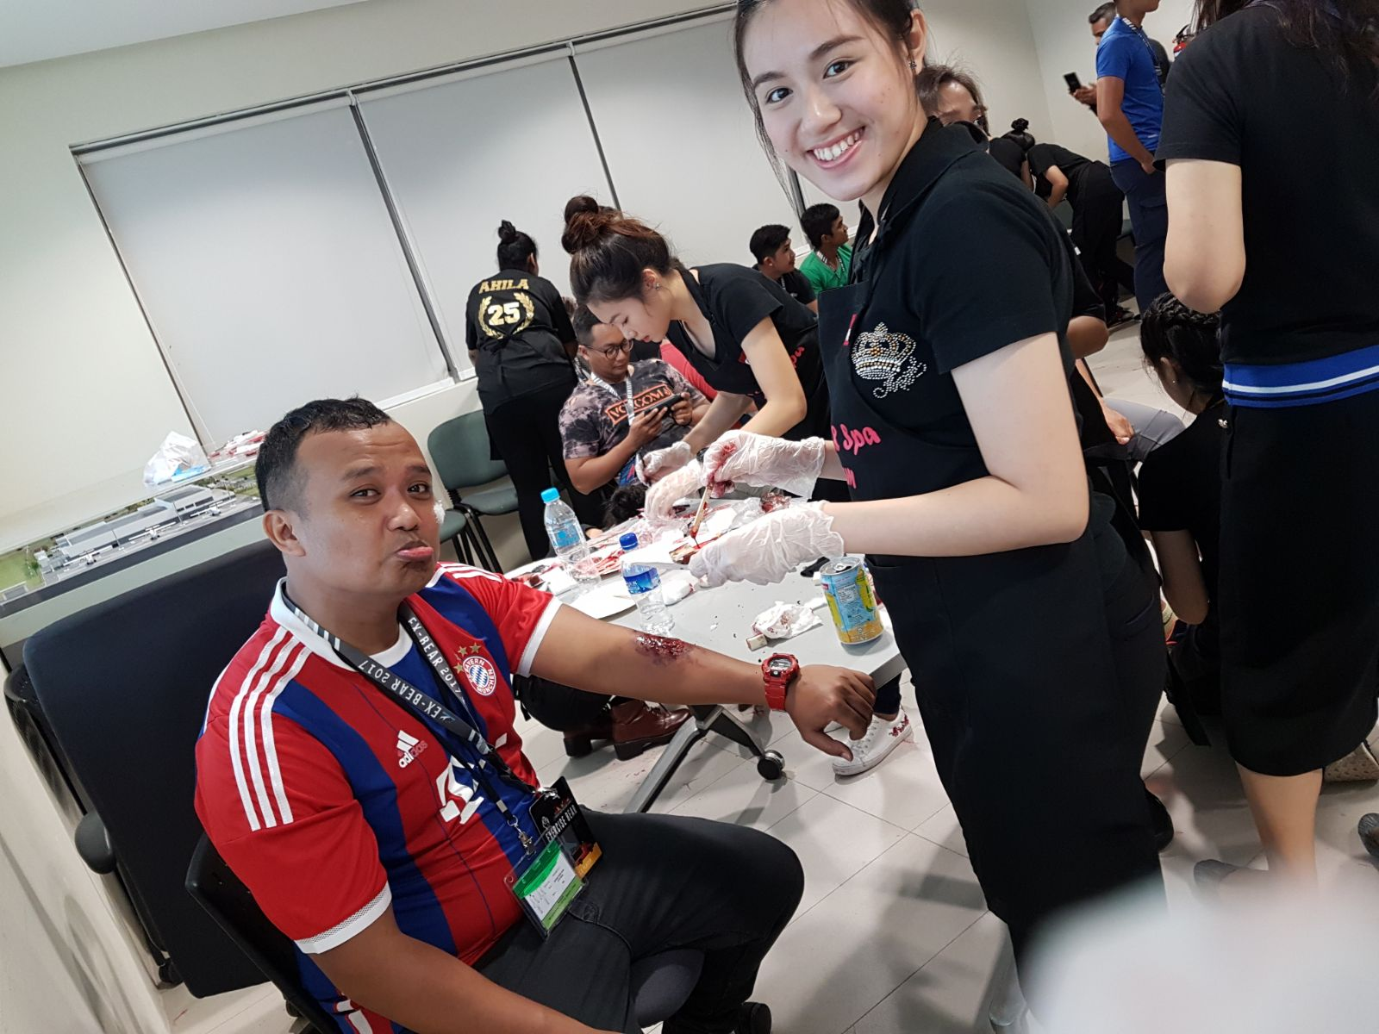
In fact...
ITE provides vocational skills and of such includes an internship that happens during the student’s 2nd year. Furthermore, they have lecturers that have prior experience in the fields of employment, which gives ITE students opportunities to hear the experiences of their teachers and apply it into their own lives.
Photo of ITE students using their skills to help others

Slide 30
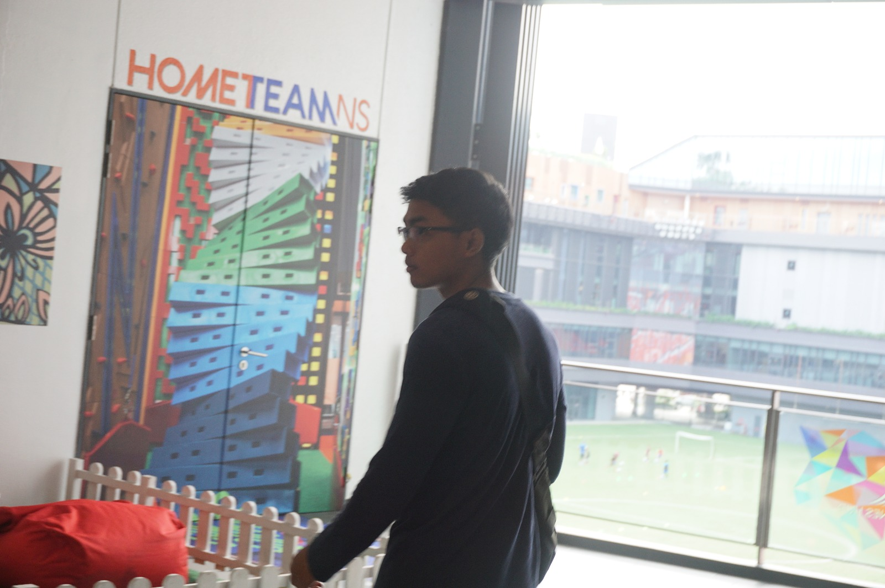
So how Nizam is doing now

Slide 31
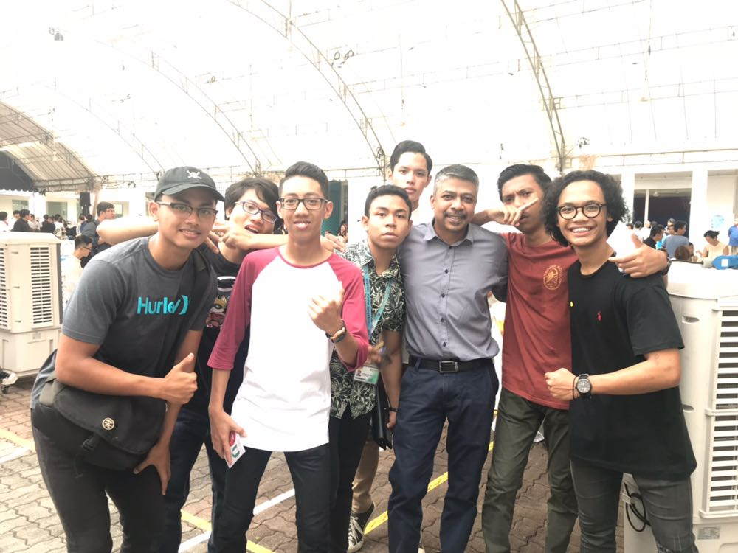
Nizam is happy where he is now
He enjoys being around his friends, and is hopeful about his future, especially with the backing of the government and supportive peers.

Slide 32
And so is Haziqah!
She decided to pursue IT Applications Development course in Higher Nitec and aims to be an widget designer in the future.

Slide 33
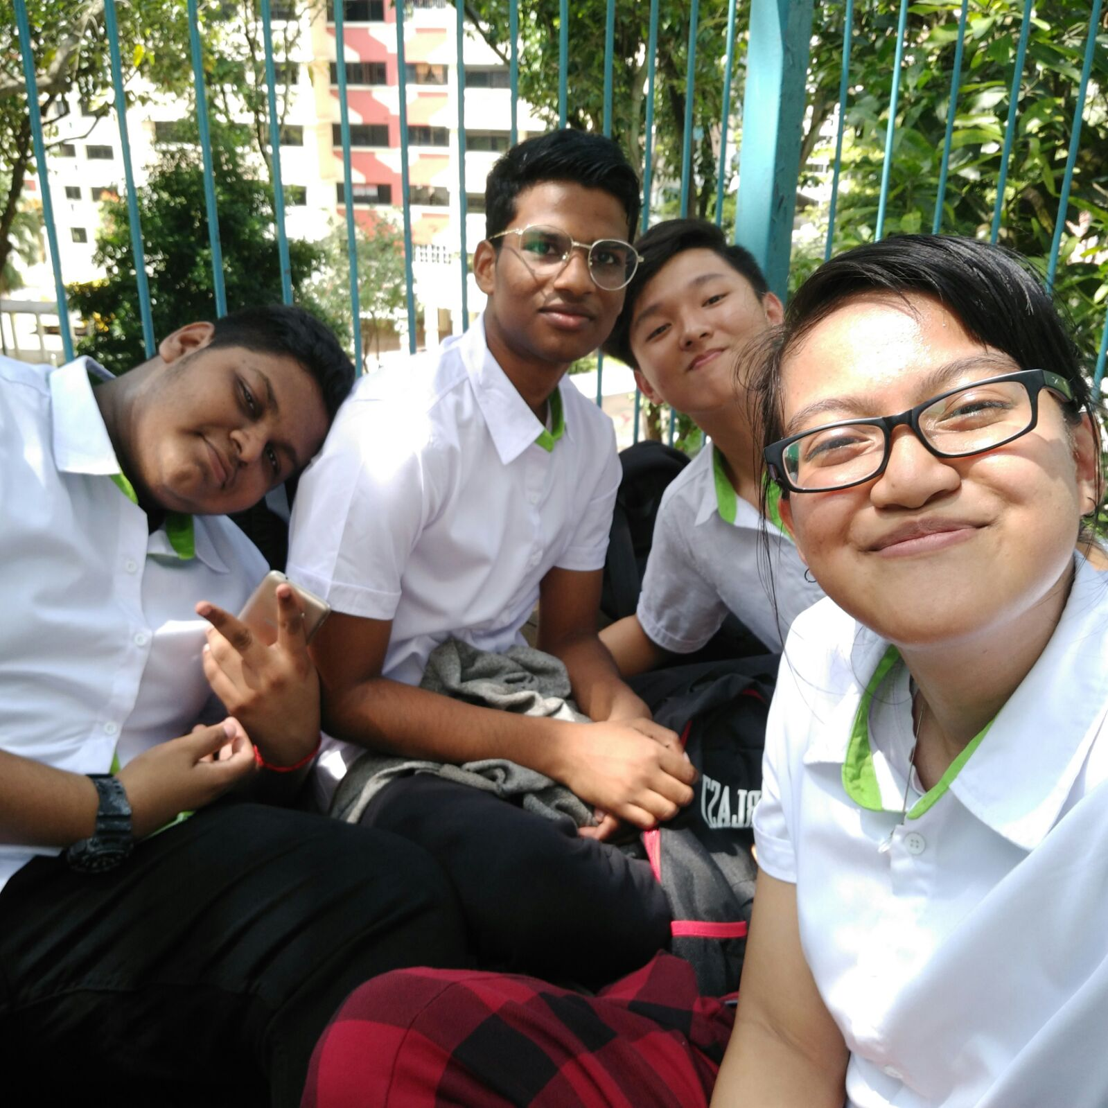
Also...
She’s found new friends that share her profound interest in creating applications and games

Slide 34
References
Jagdish.B,2016,Education about helping students find themselves, not grades: SIM Global Education,CEO,https://www.channelnewsasia.com/news/singapore/education-about-helping-students-find-themselves-not-grades-sim--7756666(15/1/2018)
Law.M,2013,We need to guard against elitism: ESM Goh,https://sg.news.yahoo.com/we-need-to-guard-against-elitism--esm-goh-024750768.html(16/1/2018) Tan,K,2016,How Singapore is fixing its meritocracy,://www.washingtonpost.com/news/in-theory/wp/2016/04/16/how-singapore-is-fixing-its-meritocracy/?utm_term=.0830bf40c92d(20/1/2018) rukiahayashi,2012,Austin Tan – Embarassing JC students while being a total douche,https://rukiahayashi.blogspot.sg/2012/10/austin-tan-embarassing-jc-students_12.html(17/1/2018) The Independent,2013,N-Level students are stigmatized,http://www.theindependent.sg/n-level-students-are-stigmatized/(16/1/2018) Aohan, Q. 2017.Equality for different education levels won't have much impact,http://www.straitstimes.com/forum/letters-on-the-web/equality-for-different-education-levels-wont-have-much-impact [15/1/2018] Law, M. 2013. We need to guard against elitism: ESM Goh, https://sg.news.yahoo.com/we-need-to-guard-against-elitism--esm-goh-024750768.html(15/1/2018) Ngering.R,2013,How Is Singapore’s Education System Unequal?,https://thehearttruths.com/2013/11/21/how-is-singapores-education-system-unequal(17/1/2018)/ The Independent,2016,ite and poly education is bad rubbish did tony tan say that,http://www.theindependent.sg/ite-and-poly-education-is-bad-rubbish-did-tony-tan-say-that/ Limpeh foreign talen,2011,Limpeh's quirky look at life in Singapore from the POV of a foreigner.http://limpehft.blogspot.sg/2011/11/singapore-education-system-vs.html(17/1/2018) MOE,2017,Education statistics digest 2017,https://www.moe.gov.sg/docs/default-source/document/publications/education-statistics-digest/esd_2017.pdf(17/1/2018)
ITE,2016,2017 Intake exercise 2017,https://www.ite.edu.sg/admission/ft/Jan17_Admissions_Booklet.pd(21/1/2018)
Picture
Tony Tan giving a speech,by Yahoo news, sg.news.yahoo.com, accessed 2018
Music
idealism – Lonely
Heavy Rain - Lofi HipHop
Music by Chillhop: http://chillhop.com/listen GYVUS - Weekend: http://soundcloud.com/gyvus Listen on Spotify: http://bit.ly/ChillhopSpotify

